Slide 1

Let's Talk about the Money!
Financial Obligations for Your College Education

Slide 2
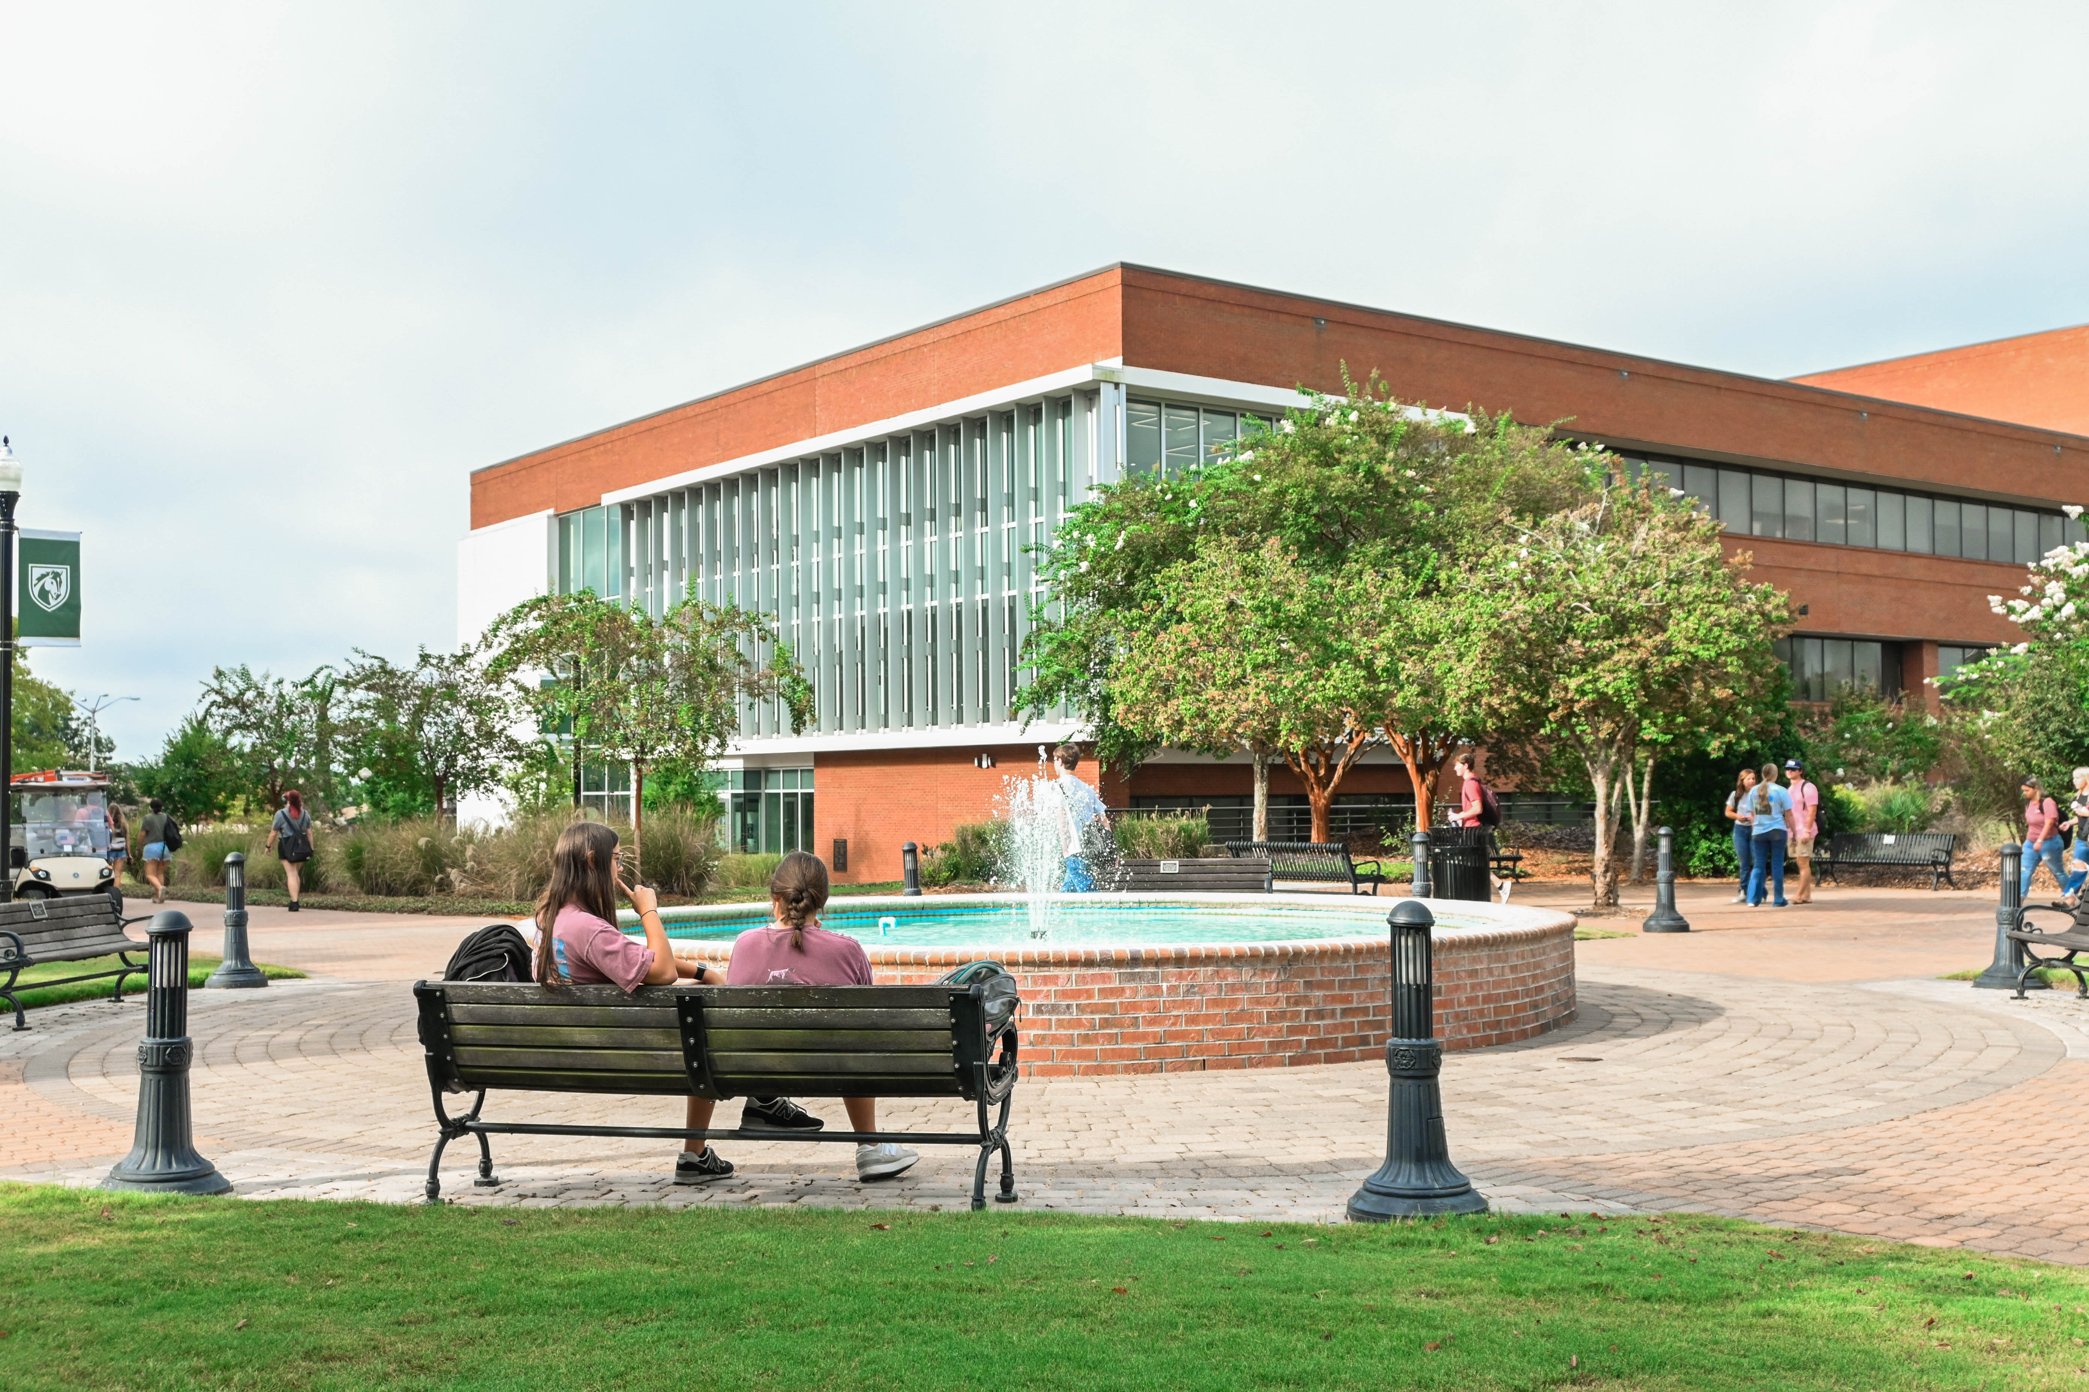
Abraham Baldwin Agricultural College
Office of Financial Aid

Slide 3
Types of Financial Aid
Federal Financial Aid
State Financial Aid Programs for Georgia Residents
Institutional Financial Aid
Other Financial Aid

Slide 4
How is your financial aid offer created?
Determine Cost of Attendance
Check for federal financial aid eligibility
Check for state financial aid eligibility
Add scholarships and other funding to the account
Emailed links are only valid for 30 days
Financial Aid Offer and College Financing Plan can be viewed on the Banner Student Landing Page at any time
COA – SAI – Financial Aid = Need

Slide 5
Federal Student Aid Programs
Federal Pell Grant
Federal Supplemental Educational Opportunity Grant
Federal Work Study
Federal Direct Loans (Subsidized and Unsubsidized)
Federal Direct Parent PLUS Loans

Slide 6
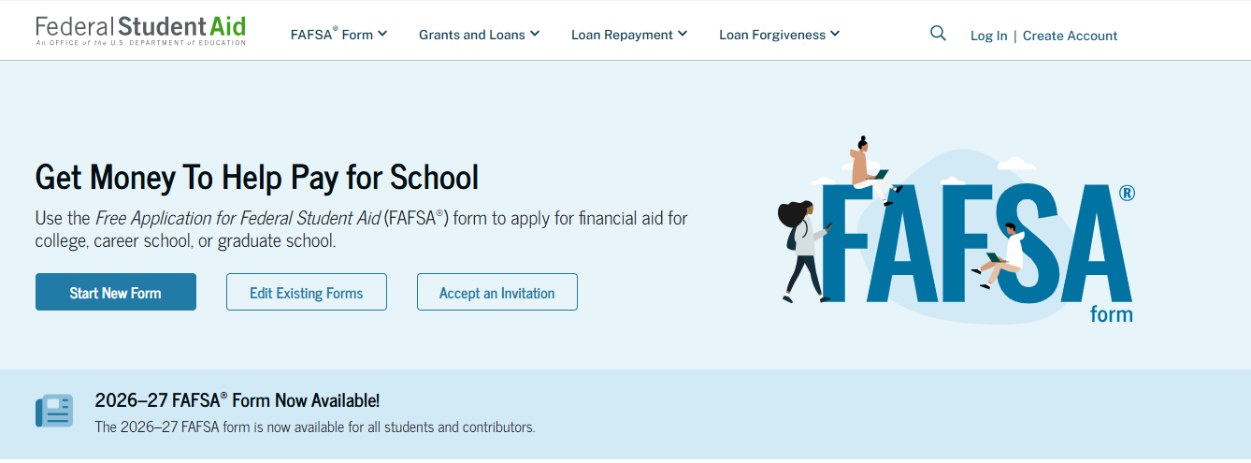
How to Apply for Federal Student Aid
Federal Student Aid
Free Application for Federal Student Aid (FAFSA)
https://studentaid.gov/h/apply-for-aid/fafsa

Slide 7
Federal Direct Student Loans
Annual Loan Limits
Grade Level | Dependent Student | Independent Student
Freshman (less than 30 hours) | $5,500 (up to $3,500 can be subsidized) | $9,500 (up to $3,500 can be subsidized)
Sophomore (30-59 hours) | $6,500 (up to $4,500 can be subsidized) | $10,500 (up to $4,500 can be subsidized)
Junior/Senior (60 or more hours) | $7,500 (up to $5,500 can be subsidized) | $12,500 (up to $5,500 can be subsidized)
Federal Direct Student Loan Interest Rate for 2026-2027 is 6.52%

Slide 8
Who can receive Direct Subsidized Loans?
Direct Subsidized Loans are available to students who demonstrate financial need.
Who will pay the interest?
The U.S. Department of Education pays the interest on a Direct Subsidized Loan
while you’re in school at least half-time,
for the first six months after you leave school (referred to as a grace period), and
during a period of deferment (a postponement of loan payments).

Slide 9
Who can receive Direct Unsubsidized Loans?
Direct Unsubsidized Loans are available to all students who successfully file a FAFSA.
Who will pay the interest?
You are responsible for paying the interest on a Direct Unsubsidized Loan during all periods.
Good to know
If you choose not to pay the interest while you are in school and during grace periods and deferment or forbearance periods, your interest will accrue (accumulate) and be capitalized (that is, your interest will be added to the principal amount of your loan).

Slide 10
Federal Direct Loan Origination Fees
The Origination Fee is the amount a borrower is required to pay the U.S. Department of Education to help defray the cost of a Federal Direct Loan.
Loan Type | Origination Fee
Subsidized & Unsubsidized Loans | 1.057%
Parent PLUS Loans | 4.228%
Example: Student accepts $5500 in the Federal Direct Unsubsidized Loan for the 2026-2027 academic year.
This amount is split equally over Fall 2026 & Spring 2027 semesters.
($2750 Fall / $2750 Spring)
Once the loan origination fee has been deducted, the net amount of $2721 will apply toward the student’s account balance in eStallion.

Slide 11
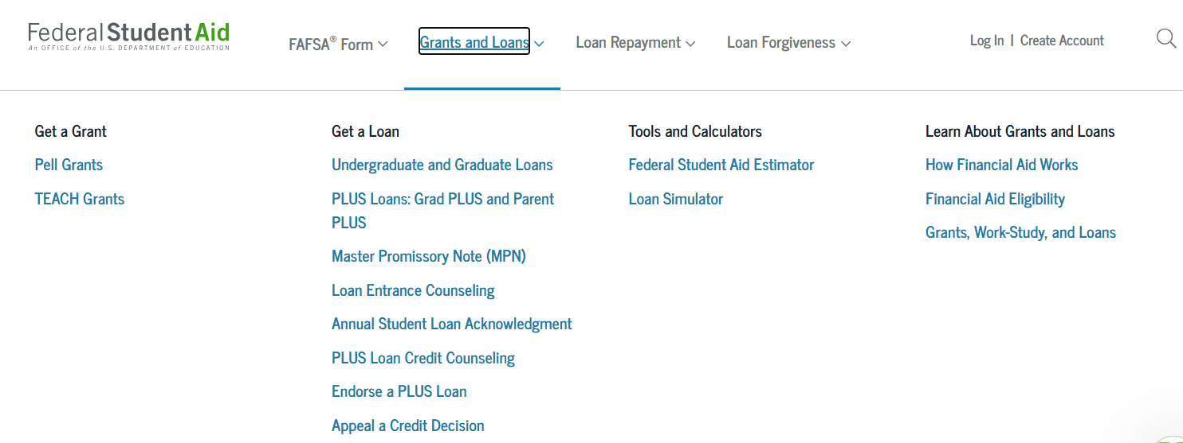
First Time Borrowers
Loan Entrance Counseling
Master Promissory Note (MPN)

Slide 12
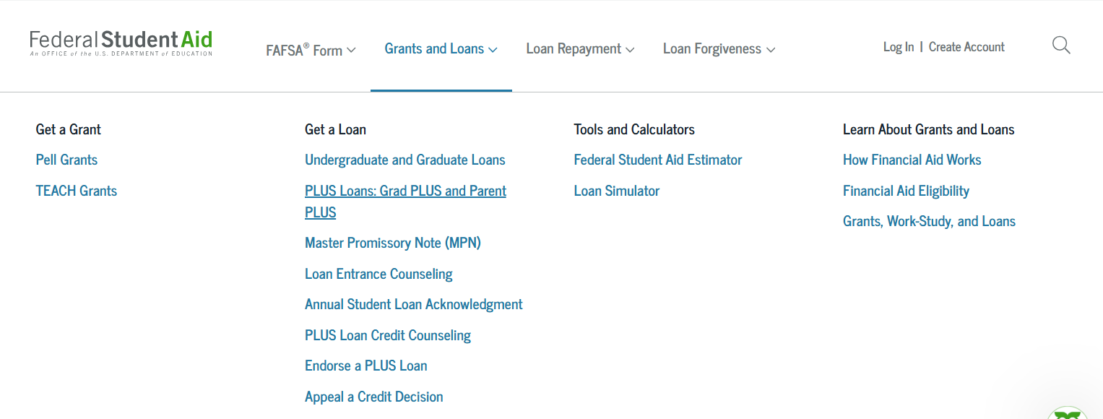
Federal Direct Parent PLUS Loans
A student must have a FAFSA on file for a parent to be able to obtain a Parent PLUS Loan.
To apply for the Parent PLUS Loan, the parent must log into studentaid.gov with the parent’s StudentAid.Gov account and apply for a Parent PLUS Loan.
New limits for Parent PLUS Loans:
$20,000 annual limit
$65,000 aggregate limit
The interest rate for Parent PLUS Loans disbursed during the 2026-27 academic year is 9.07%.

Slide 13

How to Apply for HOPE/Zell Miller Scholarships
HOPE/Zell Miller Scholarships
Two Options:
Complete the GSFAPP at gafutures.org (valid for 10 years), or
Submit a FAFSA every year
Thunder & Lightning say: Complete a GSFAPP so you always have a HOPE/Zell Miller Scholarship application on file.

Slide 14
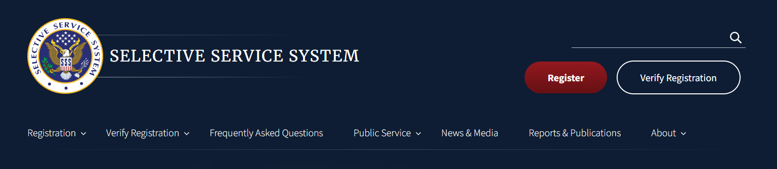
Selective Service
To receive HOPE/ Zell Miller Scholarships, a student must register with the Selective Service System or be exempt from registration.
Tips for Success:
You can register up to 30 days prior to your 18th birthday
Make sure you use your legal name, SSN and date of birth

Slide 15
HOPE Scholarship
High School Academic Eligibility
3.0 “High School” HOPE GPA AND
4 Rigorous Courses While in High School
College Academic Eligibility
Must maintain a 3.0 “College” HOPE GPA
What will HOPE Scholarship Pay (100% of Prior Year Tuition)?
For the 2026-27 academic year the HOPE per credit hour amount at ABAC is $109.00 with a maximum payment of $1,635.

Slide 16
Zell Miller Scholarship
High School Academic Eligibility
3.7 “High School” Zell GPA AND
4 Rigorous Courses While in High School AND
Test Score Component (1200 SAT Critical Reading/Math or 25 ACT)
  – Standard Policy > single test administration by High School Graduation
  OR
Be Valedictorian or Salutatorian
College Academic Eligibility
Must maintain a 3.3 “College” HOPE GPA
What will Zell Miller Scholarship Pay (100% of Current Year Tuition)?
For the 2026-27 academic year the Zell Miller Scholarship per credit hour amount at ABAC is $110.00 with a maximum payment of $1,650.

Slide 17
ABAC GPA vs HOPE GPA
ABAC GPA includes transferable courses (including Dual Enrollment).
HOPE GPA does not include Dual Enrollment courses
APPROVED STEM courses (as of Fall 2017) receive added weight for HOPE/Zell GPA calculation purposes
  ONLY applies to grades of B,C,D
  Added weight = 0.5
  Approved STEM course list is available on https://www.gafutures.org/

Slide 18
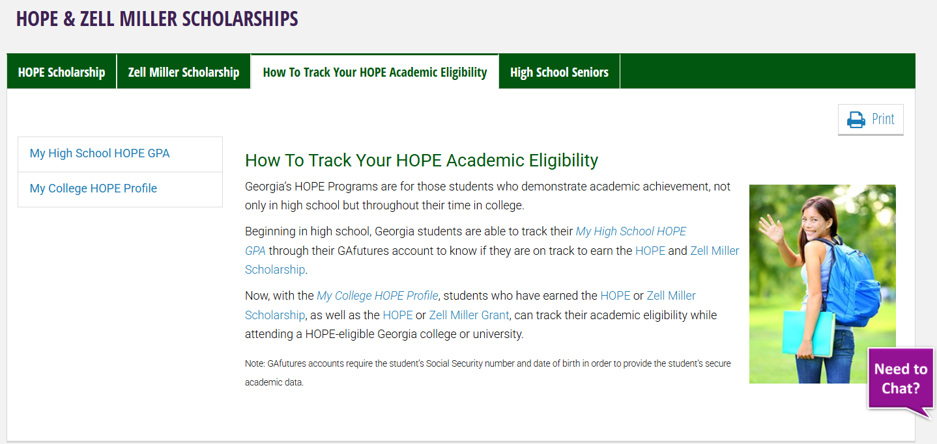
How to Track your HOPE/Zell Miller Scholarship Eligibility

Slide 19
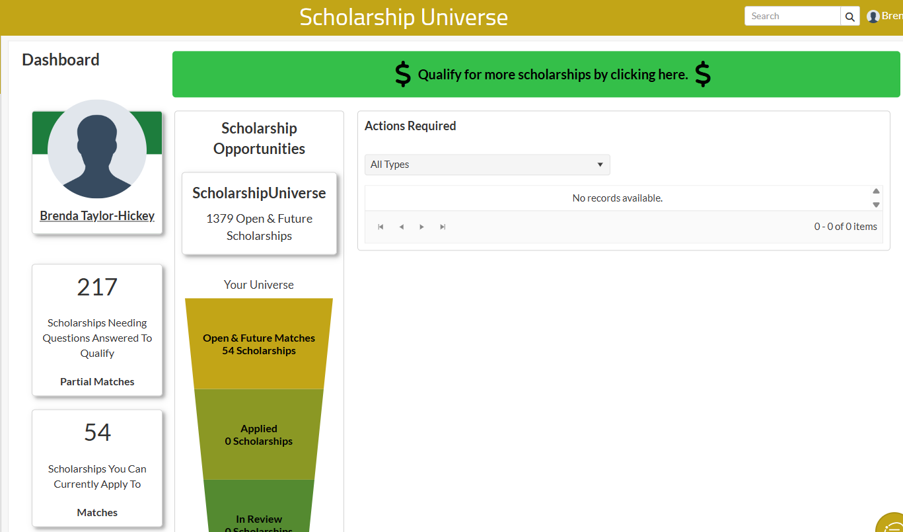
Scholarship Universe

Slide 20
Outside Scholarships
All external scholarship checks awarded to students to attend ABAC should be mailed to:
Abraham Baldwin Agricultural College
2802 Moore Hwy; Box 23
Tifton GA 31793
Attn: Brenda Corbin
Make all scholarship checks payable to Abraham Baldwin Agricultural College.
If a check is made co-payable to ABAC and the student, the student will be required to sign the check which may delay the application of the funds to the student’s account.
Be sure to include the student’s full name and ABAC ID # on the check!
Due to postal delays, we recommend that checks be mailed by July 15, 2026, so they can be posted to the student account prior to the fee payment deadline

Slide 21
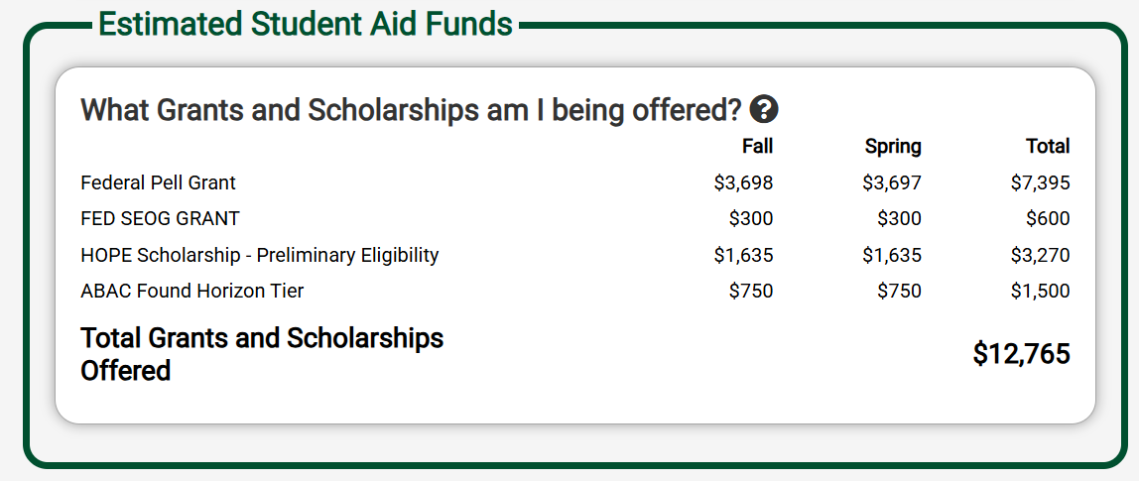
Understanding your Financial Aid Offer

Slide 22
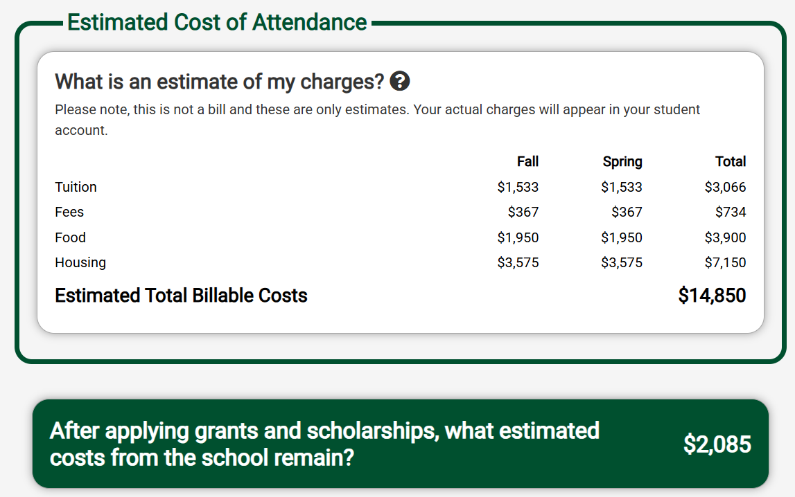
Understanding your Financial Aid Offer

Slide 23
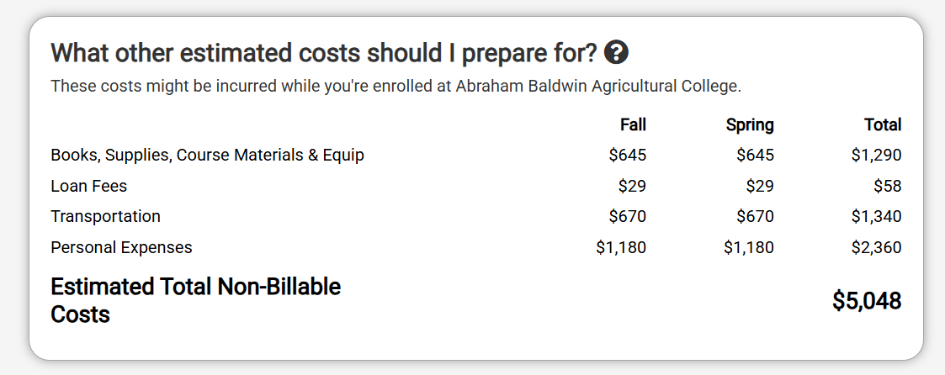
Understanding your Financial Aid Offer

Slide 24
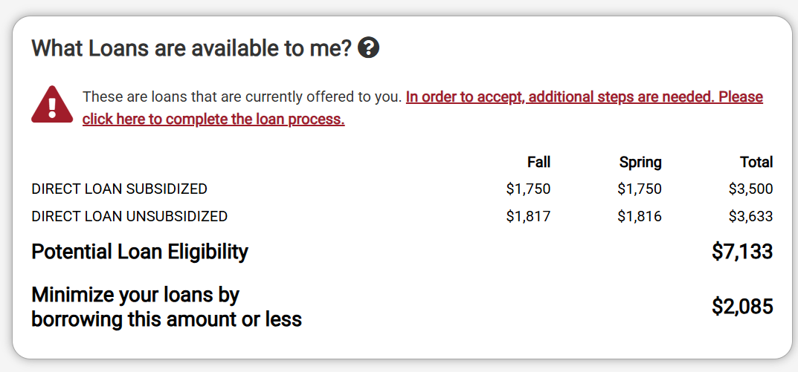
Understanding your Financial Aid Offer

Slide 25
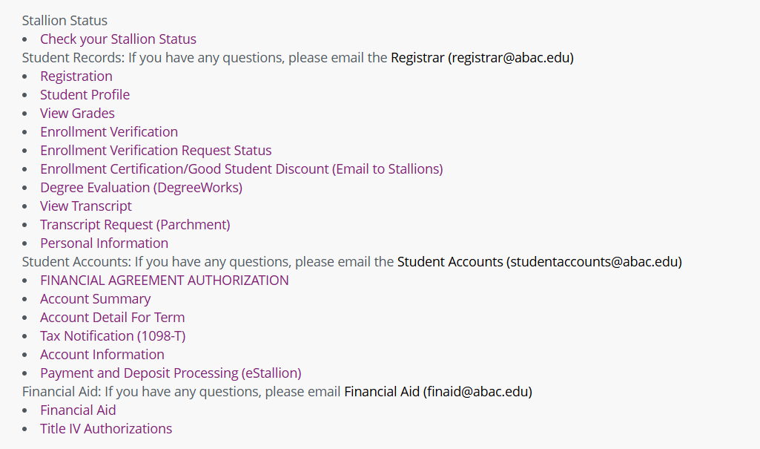
Banner Student Landing Page

Slide 26
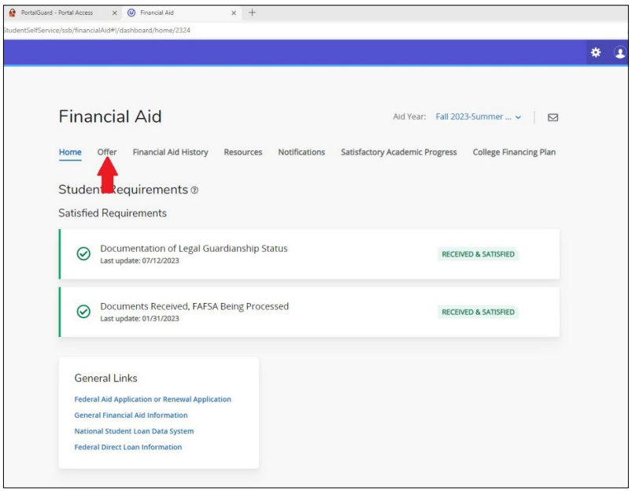
Banner Student Landing Page

Slide 27
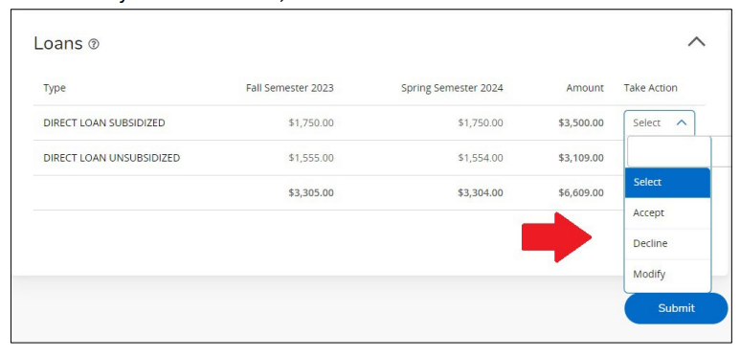
Banner Student Landing Page
Banner Student Landing Page: "Quick Click" Instructions

Slide 28
Life Happens and Situations Change
If your financial situation has changed since the 2024 tax return was filed, an SAI adjustment may be permitted.
Please email finaid@abac.edu to initiate a review to determine what documentation would be required for an appeal.
Examples of situations that may qualify for adjustment:
Loss or change of employment
Death of a parent or spouse
Appeals should be submitted by July 15, 2026, to allow for processing prior to the fee payment deadline.

Slide 29
Satisfactory Academic Progress
Required for state and federal aid as well as most institutional aid
All coursework counts in the calculation (including transfer coursework articulated by ABAC).
Three measures of progress:
  GPA – 2.0 cumulative GPA is required at the end of every semester for most majors
    2.50 cumulative GPA for AS in Nursing, BSED – Early Childhood Education, and BS Agricultural Education
  Pace – must be completing 66.67% of the courses attempted
  150% limit – must complete program of study prior to reaching 150% of the published length of the program

Slide 30
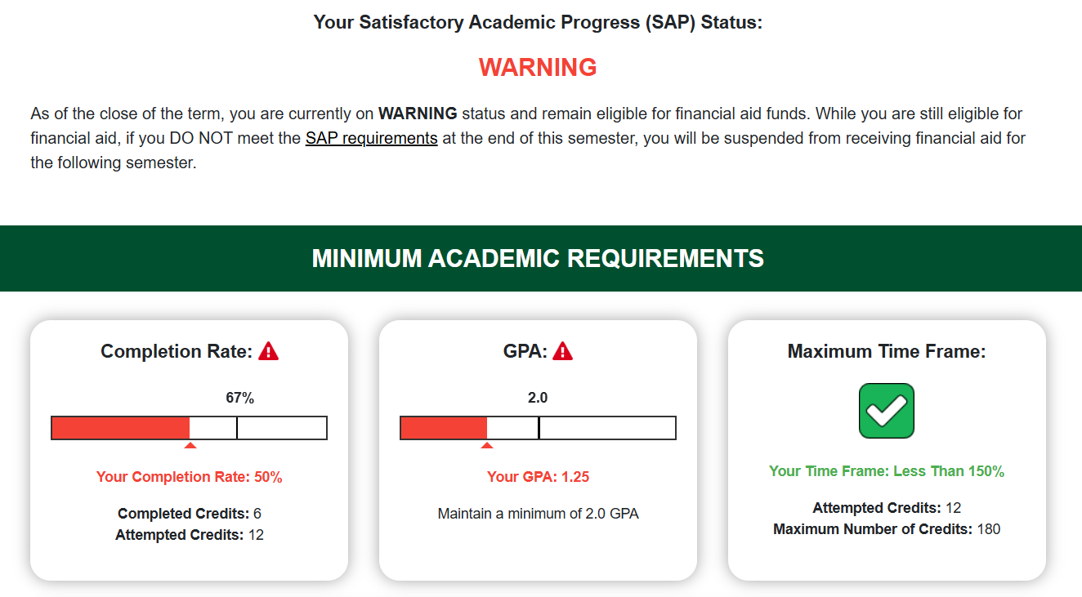
Satisfactory Academic Progress

Slide 31
What you do academically can impact you financially
Financial Aid Offers are based on Full-Time Enrollment
  HOPE – 15 hours
  Pell – 12 hours
  Loans – 6 hours minimum; loan adjusted for enrollment between 6 and 11 hours
Roster Verification
Withdrawal from some courses
Withdrawal from all courses
  Return to Title IV
Unofficial withdrawals
  Received F’s in all courses
Course Program of Study
  Coursework must count toward your official program of study for federal financial aid

Slide 32
Next Steps
Complete your FAFSA and any outstanding requirements
Check your ABAC Stallions email regularly
Submit college transcripts for Dual Enrollment coursework
Review your Financial Aid Offer
Submit outside scholarships to the Office of Financial Aid as soon as possible
Review your bill in eStallion
Accept student loans (if necessary) in Banner. Complete loan entrance counseling and a master promissory note at www.studentaid.gov.
Apply for a Parent PLUS loan (if necessary)
Accept/apply for loans by August 1, 2026, to make sure account is updated prior to fee payment deadline
Get your financial aid advice from the Office of Financial Aid!

Slide 33
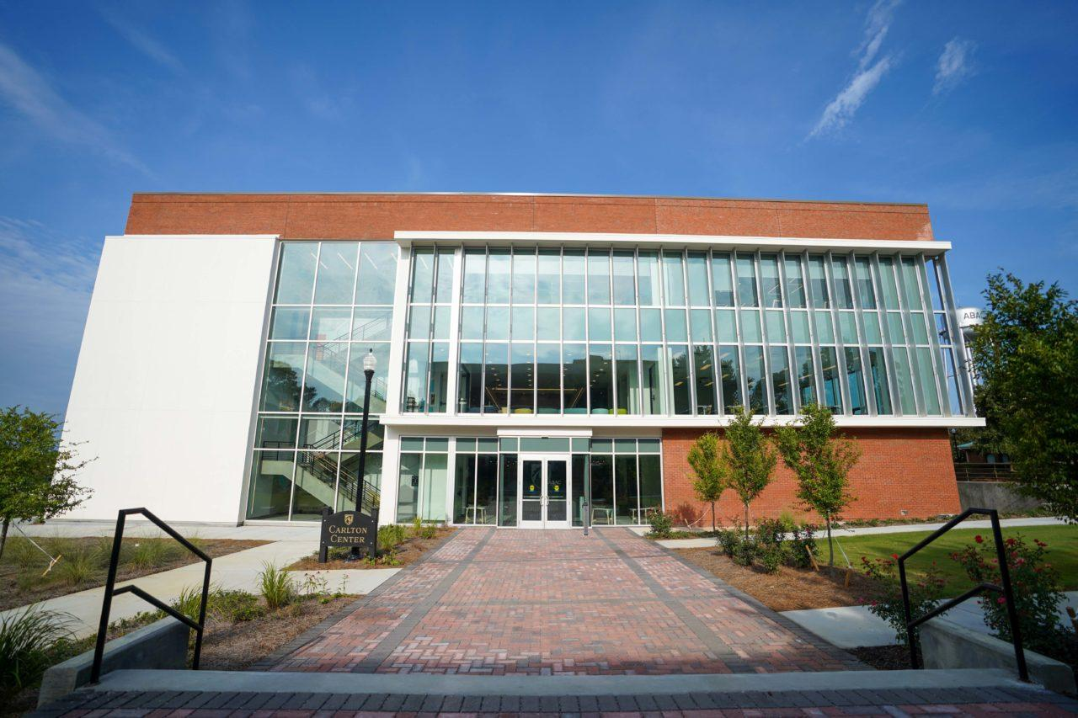
Contact Us!
Office: Carlton Center – 1st Floor
Office Hours: Monday – Friday 8:00 a.m. – 5:00 p.m.
Website: https://www.abac.edu/admissions/financial_aid
Email: finaid@abac.edu
Phone: (229) 391-4910

Slide 34
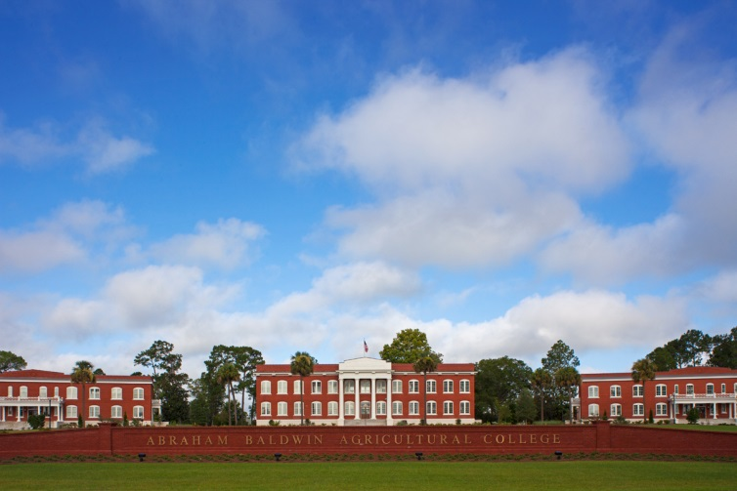
Abraham Baldwin Agricultural College
Office of the Bursar or Student Accounts
Notes:
Welcome to Stallion Day!
Thank you for the opportunity to talk to you about VA Benefits and Student Accounts at ABAC.

Slide 35



What does the Office of Bursar/Student Accounts do?
A bursar is a financial administrator within a school or university setting. Their specific role involves managing student billing. Students go to the bursar office to pay bills or set up a plan to do so. Bursars also advise students of late payments, help them set up payment plans and keep detailed records (Indeed.com, n.d.).
The word "bursar" comes from the medieval Latin word bursarius, which means "purse-bearer“ (Vocabulary.com, n.d.).
Not to be confused with Geomys Bursarius, which is the scientific name of the plains pocket gopher (U.S. Fish and Wildlife Services, n.d.).

Slide 36


Tuition and Fees Per Semester
Tuition Rates
ABAC
$110 / $435 /$448 per credit hour
(in state/out of state/out of country)
eCore
$161.00 per credit hour
Fiscal Year 2026-2027 Mandatory Fees per Semester
(Fall 2026 – Summer 2027)
Activity | $50
Athletic | $103
Health | $78
Public Safety | $30
Technology | $65
 | _____
Total: | $326
Online Learning Fee | $326
Matriculation Fee | $75
Notes:
Banner
Stallion Status –
Authorizations – Financial Agreement Authorization or Collection Cost Agreement
Agree to pay charges, fees, and fines. Otherwise, you will be turned over to collections and may be responsible for paying additional fees.
eStallion- Online Account Center
Make online payments
No additional fee for an e-check.
Additional fee of 2.85%, with a minimum of $3.00
My Account Activity – Balance, charges, and financial aid (when posted and/or disbursed)
eBills
eRefunds- If you have an excess balance after all funds/aid have been paid, excess funds will be processed. Sign up for Direct Deposit on eRefunds.
Make payments in person in OSA, 2nd floor of the J. Lamar Branch Student Hall at the Cashier window.
Nelnet Payment Plan- pay for the semester in monthly installments.
Excess Balances- Process paper checks that will be mailed to address in Banner, or Direct Deposit
Process waivers, such as the Neighbor Waiver

Slide 37
  eStallion my.abac.edu – Login with ABAC Credentials
  Click the eStallion – Bill Pay
My Account
View Account Activity
View Statements
  Billing Statements
  1098-T Tax Statements
  Real Time Statement
Payment History
eRefunds
Setup Direct Deposit for Refunds
View Refund History
My Profile
Setup Authorized Users
Save Payment Methods
Change Security Settings
Save Refund Accounts
Payment Plan
Sign up for ABAC Payment Plan
Check Stallion email ON A REGULAR BASIS!
Notes:
Stallion Status in Banner under the Student Financial Services tab shows your Admissions Checklist, Financial Aid Checklist

Slide 38
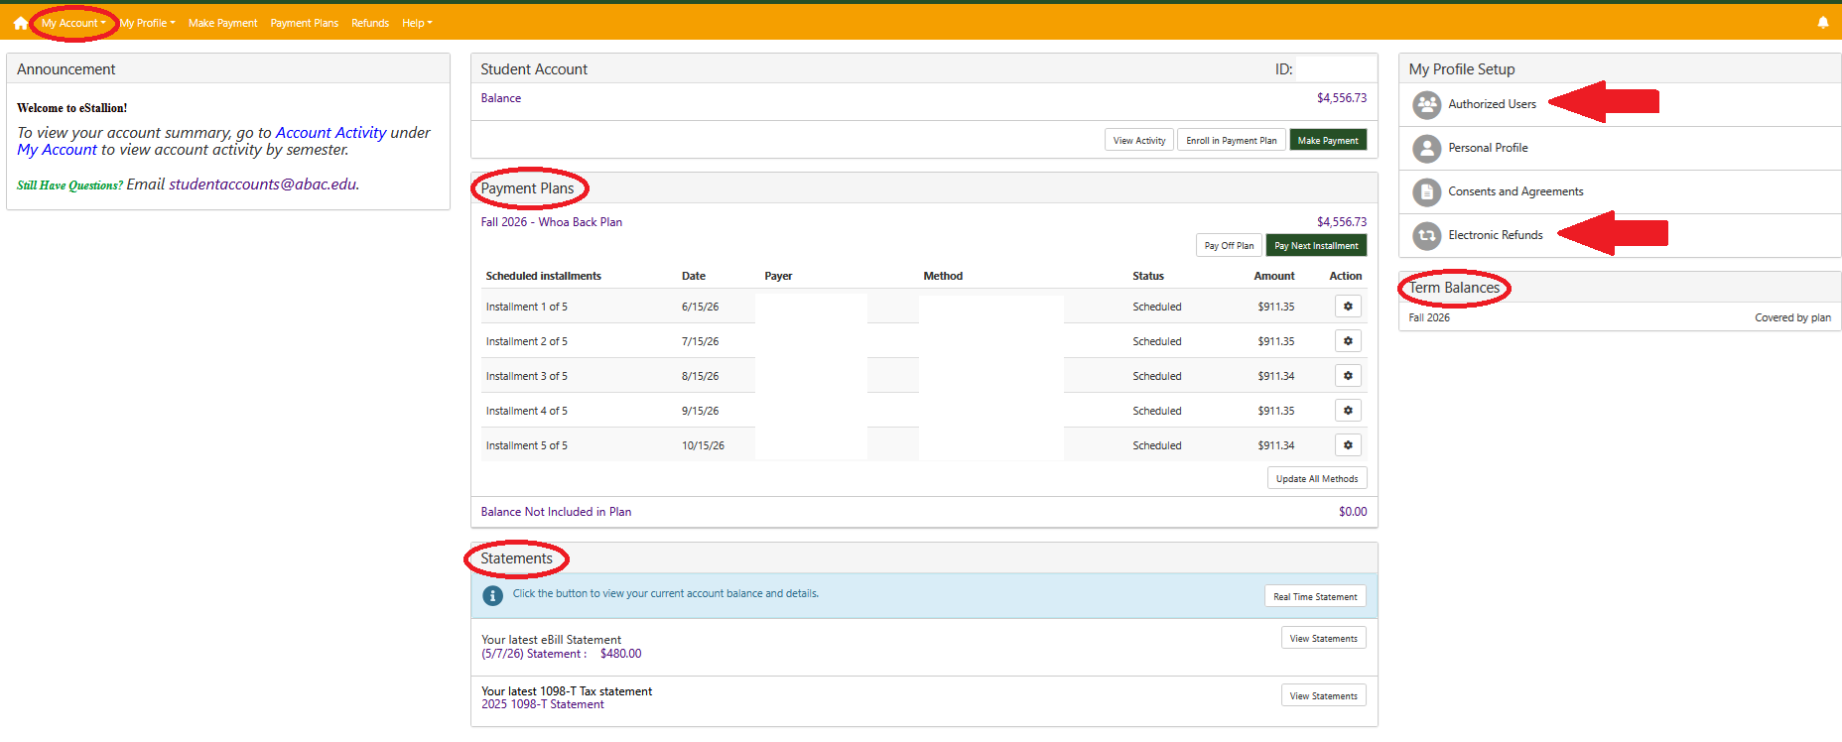
  Monitoring Your Student Account
Notes:
Stallion Status in Banner under the Student Financial Services tab shows your Admissions Checklist, Financial Aid Checklist

Slide 39
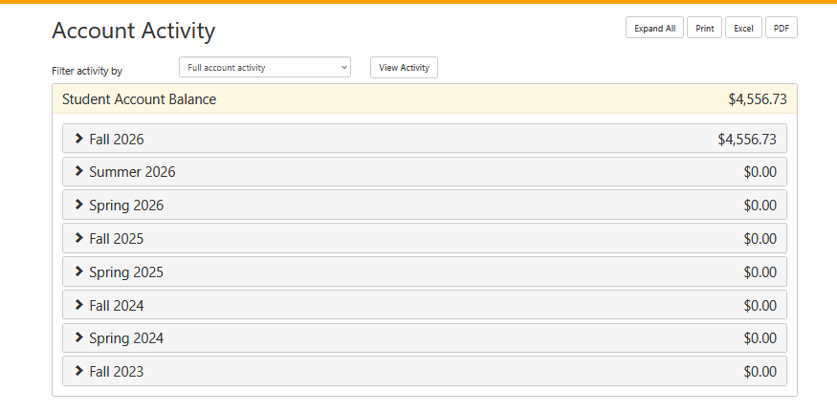
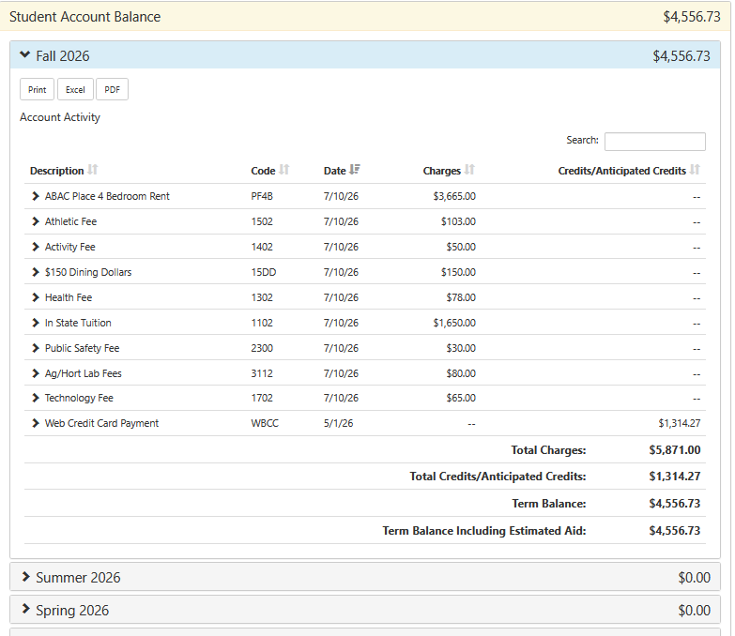
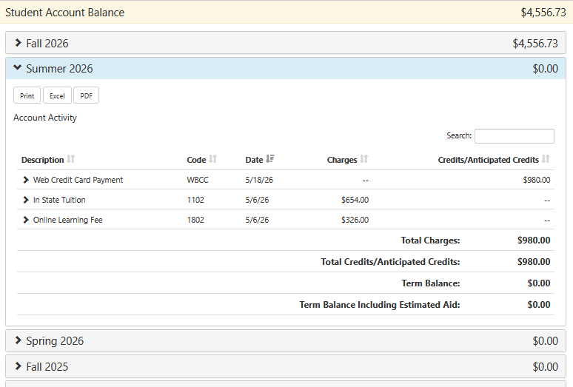

Slide 40
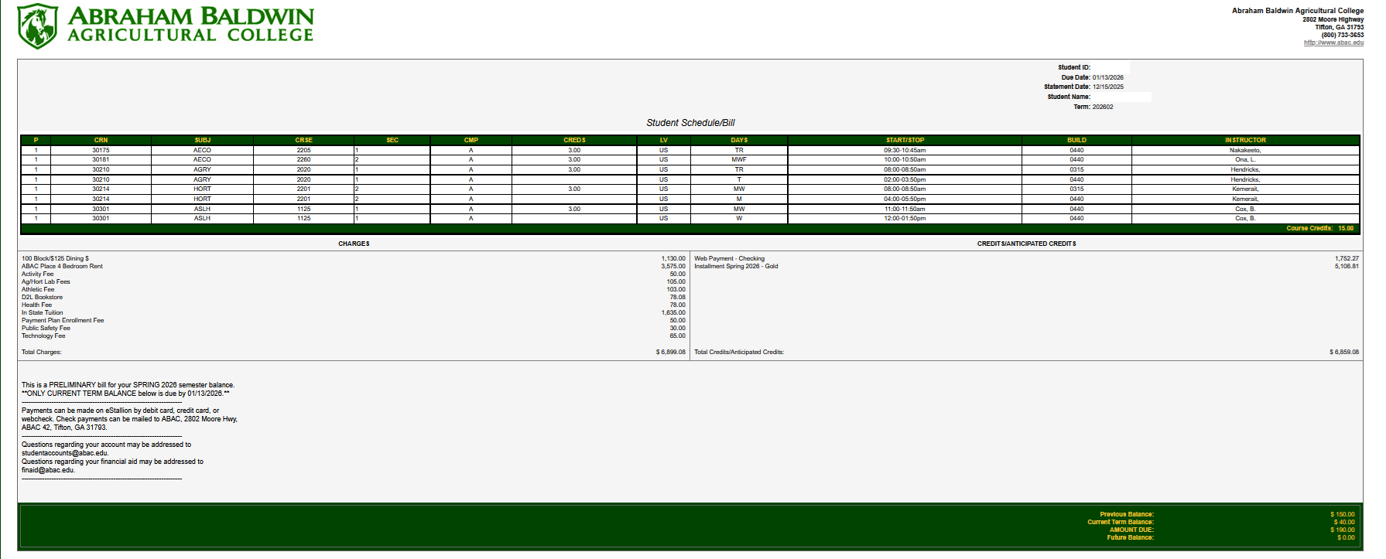

Slide 41
  Payment Deadlines
Fall 2026 dates to remember:
  1st Fee Payment Deadline: August 11, 2026
  2nd Fee Payment Deadline: August 18, 2026
    Drop/Add Activity or Registration after August 11
  3rd Fee Payment Deadline: August 25, 2026
    Drop/Add Activity or Registration after August 18
  Late Fee Assessed: August 19, 2026
  Drop/Add Ends: August 25, 2026
Notes:
Stallion Status in Banner under the Student Financial Services tab shows your Admissions Checklist, Financial Aid Checklist

Slide 42
Payment Options
Online via eStallion
  Credit and Debit Cards
    Accept MasterCard, Visa, American Express, and Discover
    3.00% convenience fee, minimum of $3.00
  Electronic Check
    No fees associated
    Store multiple bank accounts
In Person
  Cash
  Check
  Credit and Debit Cards
Payment Plan
    Non-refundable enrollment fee
    Allows payment for up to 50% of the current term’s tuition and mandatory fees, housing, and dining charges or the account balance, whichever is less. The deferred amounts are automatically drafted on predetermined installment dates.
529 Plans
    Payment should NOT exceed current amount due for the TERM.
    Please allow 10-14 days for processing after requesting disbursement.

Slide 43
ABAC’s Payment Plan
Must be set up by August 11 for Fall 2026
Cost to Participate: $25- $75 per semester
Payment Methods:
      Credit Card/Debit Card (extra fees may apply)
      ACH
    Simple Steps to Enroll:
      Log in to the MyABAC portal by navigating to my.abac.edu.
      After login, click on the eStallions – Bill/Payment app.
      Click on Payment Plans on the navigation bar, then click on Enroll Now to see the available plan.

Slide 44
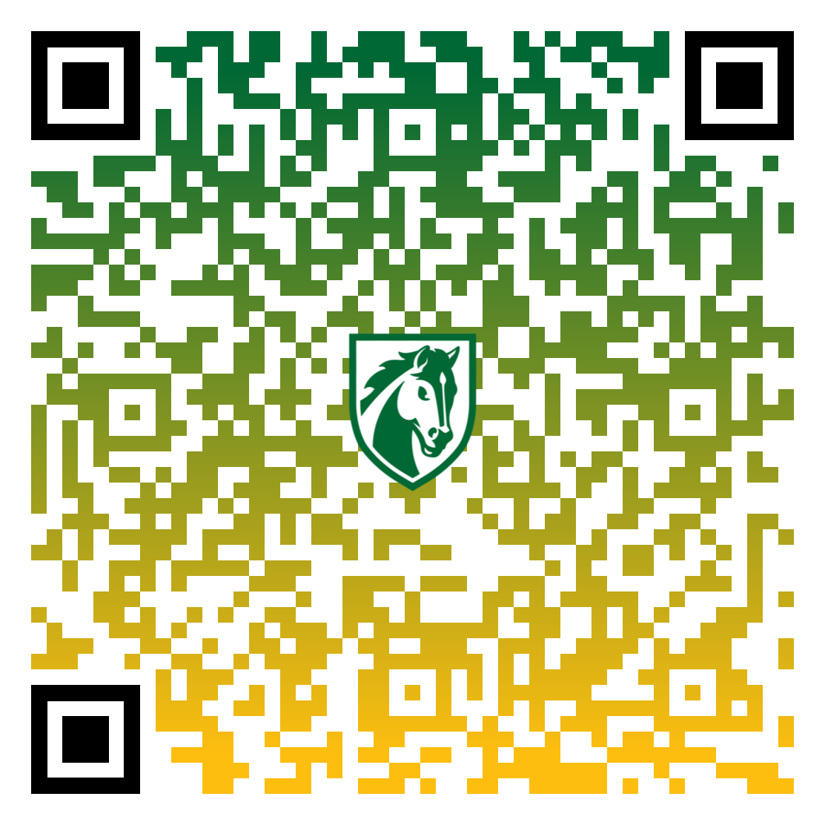
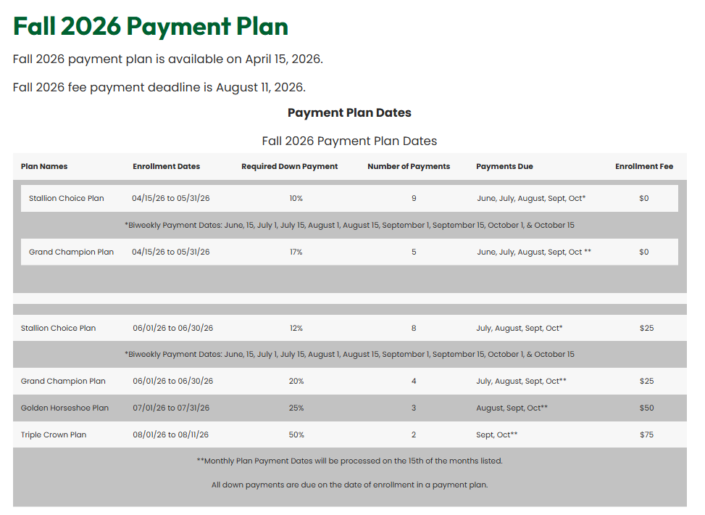

Slide 45
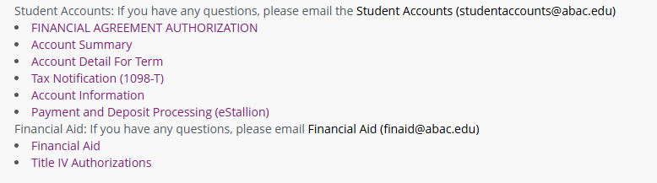
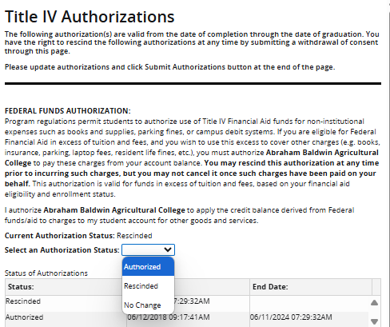
Title IV Authorizations
Federal Funds
  Allows funds to pay charges other than tuition, tuition related fees, housing, and meals
Prior Year
  Allows funds to pay prior fiscal year charges up to $200
Credit Balance
  Allows funds to move to a future semester in the same fiscal year

Slide 46
Waivers
ABAC Neighbor Waivers
  Residents of Alabama, Florida, North Carolina, South Carolina, and Tennessee are eligible for one of our new ABAC Neighbor Waivers. Eligible students can attend ABAC at the same tuition rate as an in-state student.
  Eligible students must be able to provide proof of legal residency, proof of their domicile state for the last 12 months and maintain an overall 2.0 GPA.
Other Waivers Offered at ABAC:
  Presidential Waivers
  University System of Georgia Waivers
  Military Waivers
For more information on Waivers
  Log onto www.abac.edu
  Click on Funding
  Click on Tuition and Fee Waivers

Slide 47
Third Party Billing
Florida Prepaid Plans
Veteran Affairs Benefits
WIOA (Workforce Innovation and Opportunity Act)
Sponsored Billing

Slide 48
ABAC Gold Card
Access to Housing, Thrash Gym, ABAC Legacy Pool, Meal Plans, Dining Dollars, and General Dollars
Dining Dollars utilized in Donaldson Dining Hall, Retail location, AGGI C-Store, Lakeside C-Store and vending machines
  Balances start over every semester.
General Dollars utilized in all the above plus the Stallion Shop and WEPA machines.
  Balances transfer to the next semester.
Balances for both dollars can be checked online through eAccounts portal
General dollars can be loaded online and through Phil Machines
  Located in Donaldson Dining Hall and 1st floor of the Carlton Center
NEW for Fall 2026 – Digital Credentials

Slide 49
Meal Plan Options
All housing residents are required to participate in a meal plan.
Freshmen student options (students completing less than 30 credit hours):
  12-Meal Plan = $2,010 per semester and includes $250 dining dollars
  Unlimited Meal Plan = $2,010 per semester and includes $85 dining dollars
Upperclassmen student options
  100 Block Meal Plan = $1,150 per semester including $125 dining dollars (students completing more than 30 credit hours):
  $150 Dining Dollar Only Plan (students completing 60 credit hours and are enrolled in a four-year Baccalaureate degree program)
Commuter Plans
  60 Block Meal Plan = $620 per semester
  25 Block Meal Plan = $265 per semester

Slide 50
Beginning of Semester Checklist
Grant Authorized User Access to eStallion
  Parents, guardians, etc. with separate access to view/pay bill on student’s behalf
  WILL NOT receive student account emails
Set up Direct Deposit for Refunds
  Direct Deposit is the approved method to receive financial and credit balance refunds.
Title IV Authorizations
  Banner Student Landing Page in MyABAC Portal
  READ the Authorizations before ACCEPTING
Fee Payment Deadline – Tuesday, August 11, 2025

Slide 51
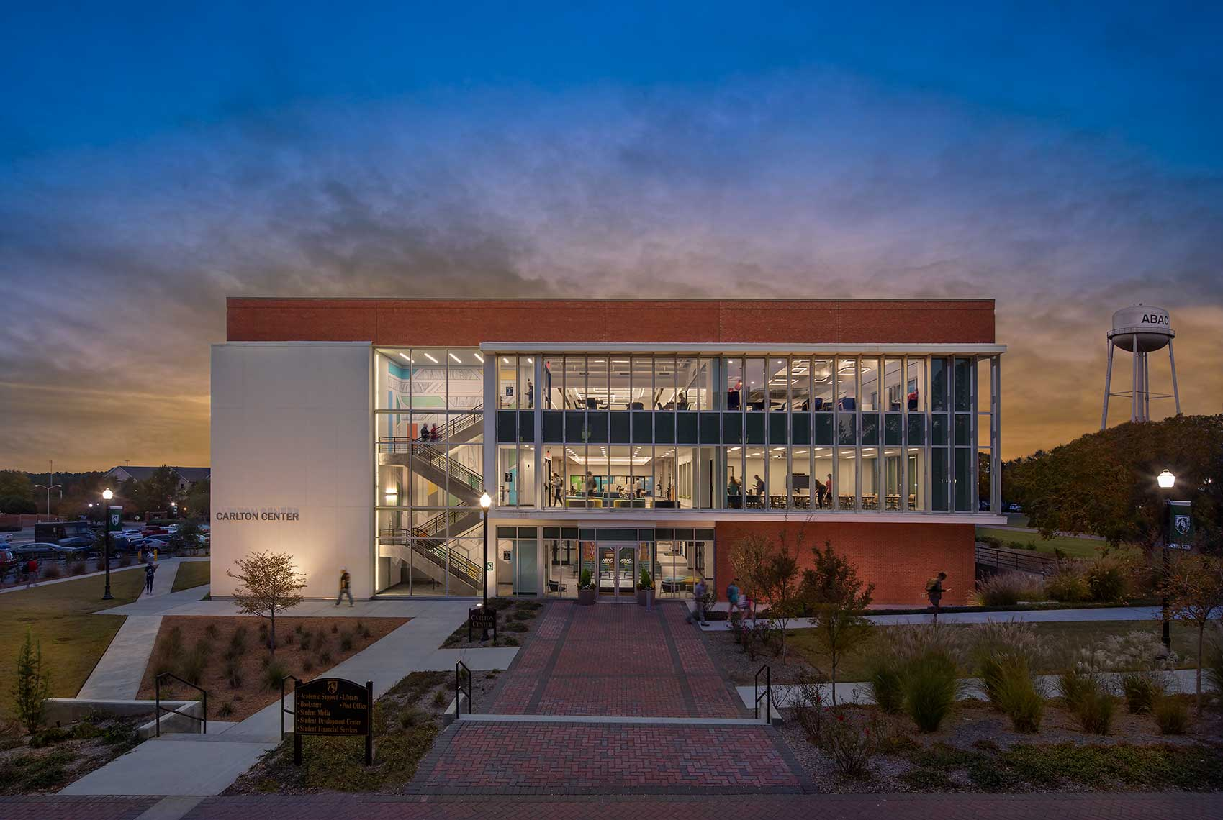
Contact Student Accounts
Office: Carlton Center – 1st Floor
Office Hours: Monday – Friday 8:00 a.m. – 5:00 p.m.
Website: https://www.abac.edu/admissions/student_accounts/index.html
Email: studentaccounts@abac.edu
Phone: (229) 391-4924
(229) 391-4999

Slide 52
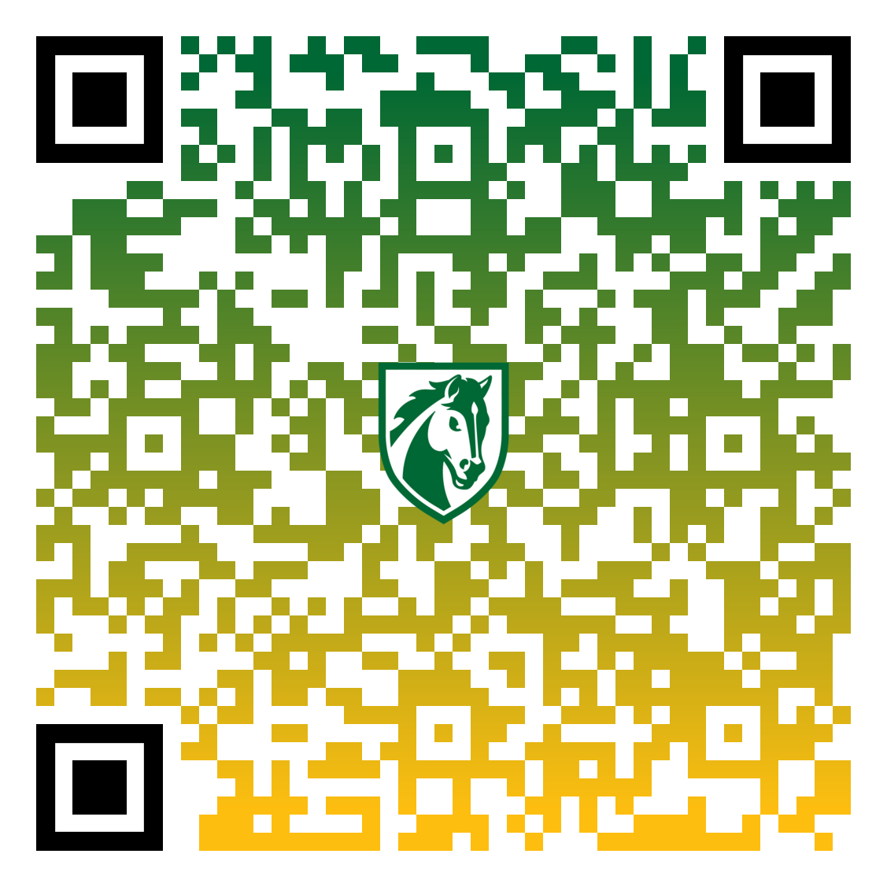
Access this presentation:

