Slide 1

Minors on Campus
Train the Trainer

Slide 2
Agenda
Single Day and Multiple Day Training
  Roles and Responsibilities (Single Day and Multiple Day)
    Code of Conduct
    Mandatory Reporting
    Relevant Institutional Policies
  Emergency Procedures
      Fire
      Inclement Weather
      Bomb Threats
      Active Shooter
      Train Accident/Derailment
      Accidents and Injuries

Slide 3
Agenda
Multiple Day Training
  Documentation (Program Specific)
  Conflict Mediation and Crisis Management
  Customer Service
  Title IX (separate training required)
  Diversity
  Confrontation
  Campus Resources
  Ethics and Role Modeling
  Parental Notification
  Youth Protection
If applicable to programs:
    Campus Health Center
    Clinic, and Hospital
    Student Transportation

Slide 4

Roles and Responsibilities
Code of Conduct

Slide 5
Part I
Single & Multiple Day Training

Slide 6
Roles and Responsibilities
Mandatory Reporting
“any program staff, ABAC employee, or volunteer who has reasonable cause to believe that suspected child abuse has occurred, shall immediately report the suspected abuse to ABAC Police and his/her appropriate supervisor or program coordinator who is able to take immediate action. ABAC must ensure that the Division of Family and Children Services is notified of the suspected abuse immediately and in no case later than 24 hours after the staff, employee, or volunteer (or other reporter) first had reasonable cause to suspect the abuse.”

Slide 7
Roles and Responsibilities
Relevant Institutional Policies
  Program Specific
    i.e.: Academic Competitions, Sports Camps
  Location Specific
    i.e.: Pool, GMA, Athletic Fields
  Population Specific
    i.e.: Age, Program Rules

Slide 8
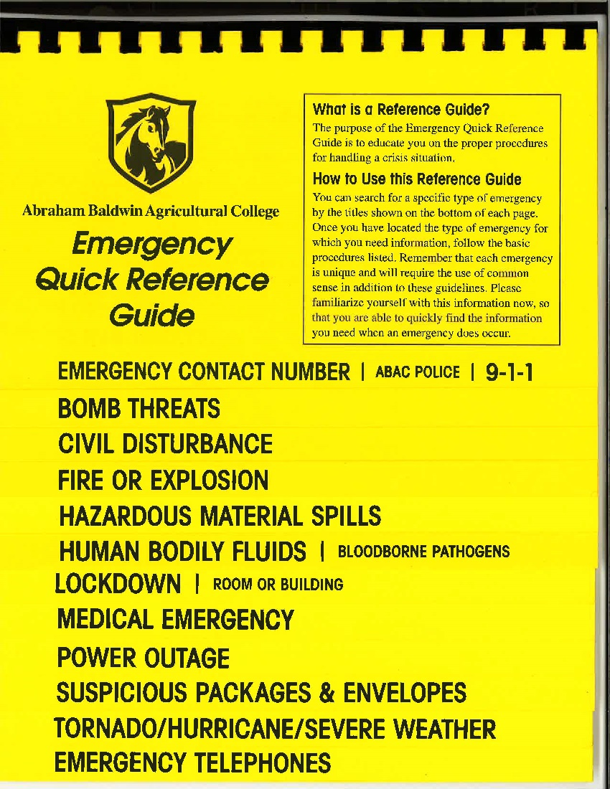
Emergency Procedures
Fire
Inclement Weather
Bomb Threat
Active Shooter
Train Accidents/Derailment

Slide 9
Emergency Procedures
First Response
  Evacuate
  Shelter In Place
  Lock Down
Communication
  Communication Center
  Staff
  Police
  Participant
  Parent
  Follow-up

Slide 10
Part II
Multiple Day Training

Slide 11
Documentation
Program Specific
File Storage
  3 years after the participant reaches 18 years of age

Slide 12
Conflict Mediation & Crisis Management
Parental Notification
Positive Reinforcement
Mediation
  Calm Down
  Direct Communication
  Active Listening (Aggrieved First to Communicate, Repeat)
  Solution Negotiation
Crisis Communication Media

Slide 13
Customer Service
Who is the Customer?
  Participant
  Parent
  Someone Else?
Focused vs. Big Picture
Servant Leadership
Be Creative
Courtesy Counts: Name some examples of courteous companies.
Amazon Motto: “Start with the customer and work backwards.”

Slide 14
Title IX
Contact for Training
  Richard L. Spancake – Director of Human Resources & Title IX Coordinator, 229-391-4887 rspancake@abac.edu
  Alan Kramer – Assistant Dean of Students/Athletic Director/Deputy Title IX Coordinator, 229-391-4928 akramer@abac.edu

Slide 15
Diversity
Know Your Population
Inclusion
Does Your Staff Look Like Your Participant?
Modeling
Know Your Biases
Abilities and Diabilities

Slide 16
Confrontation
Model
Know Your Age Group Characteristics
Remain Calm and Diffuse the Situation
Correct, Do Not Demean
Avoid Belittlement and Embarrassment
Disciplinary activities involving isolation, humiliation, or ridicule are prohibited.

Slide 17
Campus Resources
ABAC Police
Sodexo Dining
Sodexo Plant
Corvias
Residence Life & Housing
Admissions
Marketing & Communications
Athletics
Howard

Slide 18
Ethics & Role Modeling
Civility
Examine Your Own Mores, Ethics, and Moral Code
“Look in a Mirror”
You are not Responsible for Re-Education

Slide 19
Parental Notification
Program Specific Requirements
Ere on the Side of Caution

Slide 20
Youth Protection
Rule of Two
One on One Contact Prohibited
Rules Apply to Digital Communication
Separate Housing Accommodations
Buddy System
Respect Youths’ Privacy
Cameras and Pictures
Secrets vs. Surprises
Appropriate Attire

Slide 21
Youth Protection – Your Response
Stop the policy violation or abuse
Protect the youth
Separate alleged victim from alleged perpetrator
Summon needed assistance (911, Campus Police, additional leaders, etc.)
Notify Supervisor
  Supervisor will Notify ABAC Administration & Parent

Slide 22
If Applicable to Program
Campus Health Center
Clinic, and Hospital
Student Transportation

